Slide 1
Chapter 4 Part II
Subatomic Particles
Last revised October 22, 2014

Slide 2
Determining the number of Protons and Electrons

Slide 3
Atomic #→ # Protons→# e⁻ when neutral
Isotopes→ Atoms of same element with different # of neutrons
Mass #→ Atomic mass rounded off to a whole number

Slide 4
Electron Cloud Model

Slide 5
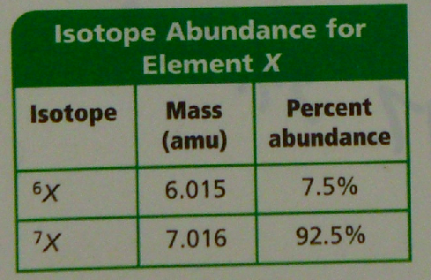
Calculating Average Atomic Mass
Mass# - Atomic # = # Neutrons
Atomic Mass = Average of all isotopes of an element
(Do examples 4-3 pg. 103)

Slide 6
Determine the number of Protons, Neutrons and Electrons in:
Na
Fe
Br

Slide 7
2n² and energy levels
Principal Quantum Number and Energy Levels
n = Energy Level | Maximum Number of e⁻ that fit into an energy level
1 | 2
2 | 8
3 | 18
4 | 32
5 | 50
6 | 72
7 | 98

Slide 8
Nuclear Reactions
Nuclear Rxn. →Involve changes in atom’s nucleus
Radiation- Rays and particles emitted from radioactive material (unstable nuclei)

Slide 9
Types of Radiation
Alpha ( α )- radiation deflected toward negative charge made of alpha particles
Beta ( β )- Deflected toward positive charged plate made up of beta particles
Gamma (γ ) High-energy radiation
No electric charge
not deflected

Slide 10
Nuclear Equations- New element created due to nuclear reactions
Both mass # and atomic # must be conserved
${}_{}^{\begin{aligned}226 \\ 88\end{aligned}}{Ra}$→ ${}_{}^{\begin{aligned}222 \\ 86\end{aligned}}{Rn}$ ⁺ ${}_{}^{\begin{aligned}4 \\ 2\end{aligned}}{He}$ ($α$ alpha particle)
${}_{}^{\begin{aligned}14 \\ 6\end{aligned}}C$→ ${}_{}^{\begin{aligned}14 \\ 7\end{aligned}}N$ ⁺ ${}_{}^{\begin{aligned}0 \\ −1\end{aligned}}{\text{β}}$ (β beta particle)
${}_{}^{\begin{aligned}238 \\ 92\end{aligned}}U$→ ${}_{}^{\begin{aligned}234 \\ 90\end{aligned}}{Th}$ ⁺ ${}_{}^{\begin{aligned}4 \\ 2\end{aligned}}{He}$ ⁺ ²${}_{}^{\begin{aligned}0 \\ 0\end{aligned}}γ$ ($γ$ gamma particle no mass)

