Slide 1
Animals & Humans
Nervous & Response

Slide 2
Why do animals need to be able to respond?
Protection
Maintain homeostasis
Survival

Slide 3
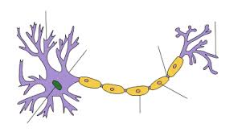
Neurons
Special cell designed to transmit information throughout animals

Slide 4
Nerve nets
Hydra and jellyfish

Slide 5
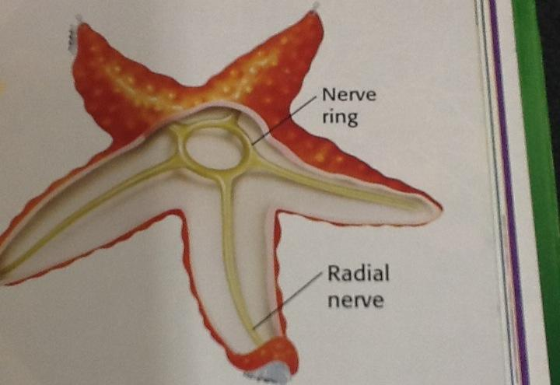
Nerve cord

Slide 6
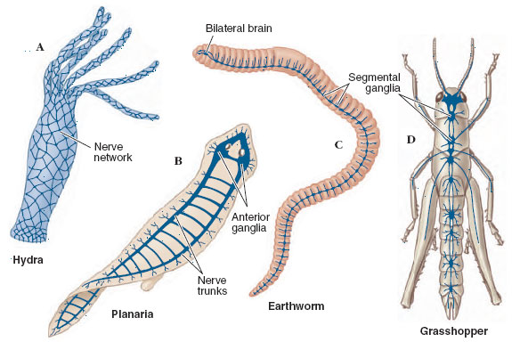
Ganglion (Ganglia)

Slide 7
Cephalization
Clear indication that there is a head on the animal
Will contain one large ganglion

Slide 8
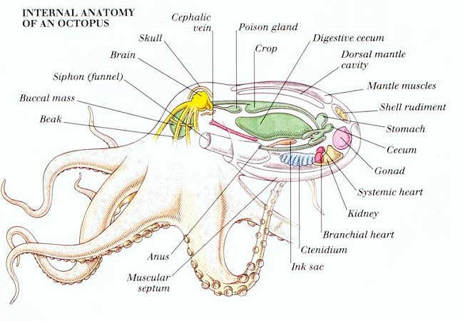
Brains
Simple brains are found in some mollusks

Slide 9
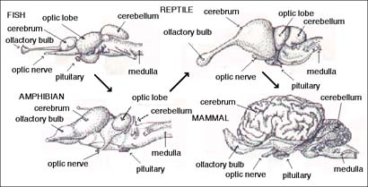
Vertebrate brains: cerebrum, cerebellum, medulla oblongata

Slide 10
Senses
Eyespots & eyes
Ears, tympanic membranes
Electric sense
Smell - noses and tongues
Antennae
Hormones

Slide 11
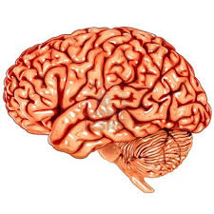
Humans
Brain with well developed cerebrum used for thinking and memory
Nerves used to transmit information from one area of the body to another

Slide 12
Developed senses
Eyes
Ears
Smell
Skin

Slide 13
Immune Response
Our body’s ability to fight off foreign invaders
Skin
Body secretions
White blood cells
Antibodies

Slide 14
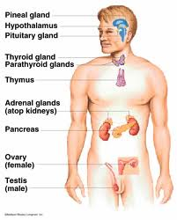
Endocrine System
System of glands that secrete hormones
Chemical messengers that tell body to do different tasks

Slide 15
Hormones
Insulin
Growth hormone
Testosterone & estrogens
Epinephrine & adrenaline

