Slide 1
Animals & Humans
Movement & Support

Slide 2
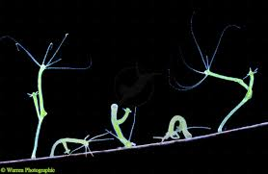
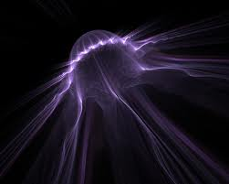
Hydrostatic Skeleton
Flexible
Allows organism to change shape

Slide 3
Exoskeleton
Outside skeleton
Hard outer covering made of chitin
Some are shells made of calcium carbonate
Provides waterproof coating, protection, attachment site for muscles
Problems:
Molting
Heavy

Slide 4
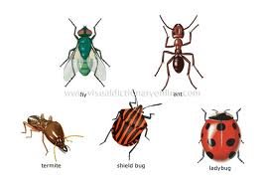
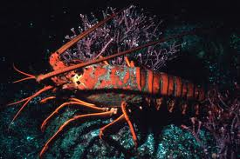
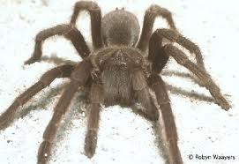
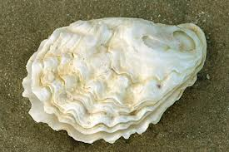

Slide 5
Endoskeleton
Inside skeleton
Can be made of calcified plates, cartilage, or bone
Joints allow limbs to bend

Slide 6
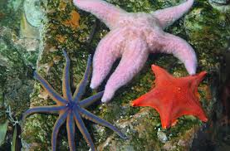
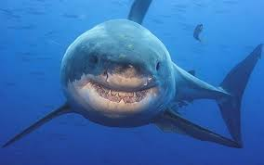
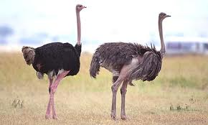
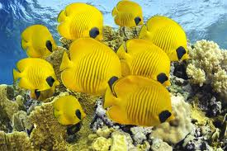
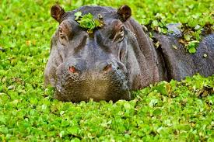

Slide 7
Muscles & Movement
Muscles produce movement by contracting
Must have something to work with in order to produce movement
Attach to bones, using tendons, to produce movement
Often work in pairs

Slide 8
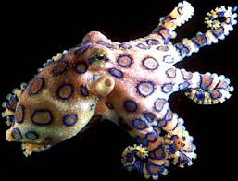
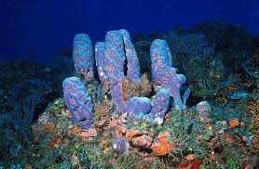
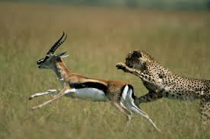
Some animals do not move – sessile
Legs, wings, fins, tentacles,

Slide 9
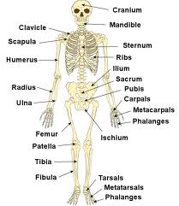
Humans - Skeleton
Endoskeleton
206 bones
Used for protection, support, muscle attachment, mineral storage,

Slide 10
Humans - Muscles
Three types of muscle – cardiac, smooth, and skeletal
Joints, tendons, ligaments
Muscles work in antagonistic pairs to create movement – voluntary movement

Slide 11
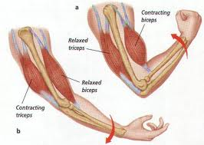
Antagonistic Muscle Pairs

