Slide 1
Chemistry Skills
Scientific Method
Graphing
Qualitative v. Quantitative Data
Scientific Notation
Significant Figures
Measurements and Units (Certain v. Uncertain Digits)
Unit Conversions (Dimensional Analysis)
Accuracy and Precision

Slide 2
Scientific Method
Independent variable
Dependent variable
Control
Hypothesis
Theory
Scientific Law

Slide 3
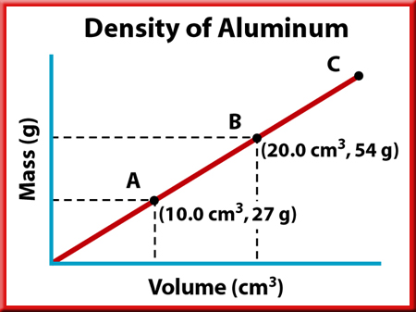
Graphing
The “Good Graph Checklist”:
Descriptive titles!
Labels!
Graph takes up most of the graph paper!

Slide 4
Qualitative v. Quantitative Data
The following observations are qualitative.
The building is really tall.
It takes a long time for me to ride my bike to the store.
I live really far away.
The following observations are quantitative.
The river is 31.5 m deep.
The cheese costs $4.25 per pound.
It is 75º F outside today.

Slide 5
Scientific Notation

Slide 6
Scientific Notation
Written in the form:
6.02 x 10 ²³
Only one digit to the left of the decimal place (Must be non-zero)
Positive exponent indicates a large number (ie. Decimal would move to the right when writing in long form)
Negative exponent indicates a small number (ie. Decimal would move to the left when writing in long form)
Discuss Addition and Subtraction
Discuss Multiplication and Division
Scientific Notation and the calculator.

Slide 7
Measurements and Unit Conversions

Slide 8
Unit Conversions

Slide 9
A kilogram is about 2.2 pounds. The kilogram is defined by a platinum-iridium metal cylinder. Kept in Sèvres France.

Slide 10
The Fundamental SI Units

Slide 11
Derived Units
Volume
1mL = 1cm³
1L = 1 dm³
Density= mass per unit volume
Density units g/mL (solids and liquids) or g/L (gases)

Slide 12
King Hector Drove My Dad’s Car Monday

Slide 13
Large SI Prefixes
Size compared to base unit
Exa E 10¹⁸
Peta P 10¹⁵
Tera T 10¹²
Giga G 10⁹
Mega M 10⁶
Kilo k 10³
Hecto h 10²
Deka da 10¹
Base unit 1

Slide 14
Small SI Prefixes
Size compared to base unit
Base
Deci d 10⁻¹
Centi c 10⁻²
Milli m 10⁻³
Micro μ 10⁻⁶
Nano n 10⁻⁹
Pico p 10⁻¹²
Femto f 10⁻¹⁵
Atto a 10⁻¹⁸

Slide 15
Unit Conversions (Dimensional Analysis)

Slide 16
Dimensional Analysis
Dimensional Analysis/Factor Labeling/Cross-cancel
A method of problem solving involving conversion factors equal to 1
Units must always cancel to give desired units
See page 34

Slide 17
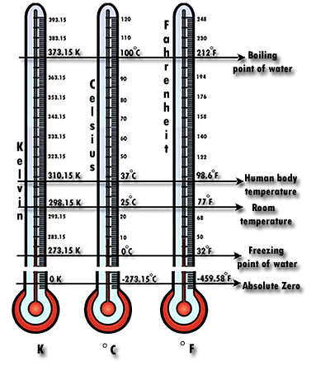
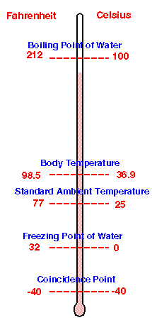
Temperature Scale Comparisons

Slide 18
Temperature Conversions
ºC degrees Celsius
K Kelvin Temperature or Absolute Temperature
ºF degrees Fahrenheit
Water boils at 100ºC and 212ºF
Water Freeze/Melts at 0ºC and 32ºF
Discuss deriving ºF→ºC equations
Notes:
See fig 1.8 pg 22 for deriving equations
212-32 = 180
100-0 = 100
180/100 = 9/5
Subtract 32 from degrees Fahrenheit in order to obtain zero position

Slide 19
Percent Error

Slide 20
Accuracy v. Precision

Slide 21
Accuracy v. Precision

Slide 22
Accuracy vs. Precision
See figure 2-9 page 36

Slide 23
Accuracy vs. Precision

Slide 24
Significant Figures

Slide 25
Significant Figures
A measurement can only be as accurate and precise as the instrument that produced it.
A scientist must be able to express the accuracy of a number, not just its numerical value.
We can determine the accuracy of a number by the number of significant figures it contains.

Slide 26
Significant Figures

Slide 27
Rules for Counting Significant Figures - Details
Nonzero integers always count as significant figures.
3456 has
4 sig figs.

Slide 28
Rules for Counting Significant Figures - Details
Zeros
Trailing zeros are significant only
if the number contains a decimal point.
9.300 has
4 sig figs.

Slide 29
Rules: Significant Figures Summary
Nonzero integers are always sig.
Zeros
Leading → not sig.
In Between → always sig.
Trailing → sig. if decimal place present
Exact Numbers → all digits are sig. (ex: counted numbers)
Notes:
12345
0.000001
1001
100.0
3. 32ºF is = 0ºC

Slide 30
Rules: Significant Figures In Calculations

Slide 31
Rules for Significant Figures in Mathematical Operations
Multiplication and Division: # sig figs in the result equals the number of significant digits in the least precise measurement.
14.5 cm x 12.26543 cm =
177.848735 cm² → 178 cm² (3 sig figs)

Slide 32
Rules for Significant Figures in Mathematical Operations
Addition and Subtraction: # sig figs in the result equals the number of decimal places in the least precise measurement.
6.8 cm + 11.934 cm =
22.4896 cm → 22.5 cm (3 sig figs)

Slide 33
Sig. Figs. in Calculations Summary
Multiplication and Division
Number of Sig. Figs. is equal to the number with the least sig. figs.
Addition and Subtraction
Same as the number of decimal places in the number with the least decimal places (least precise)
Rounding
Carry extra digits through calculations then round
1.45 = 1.5 1.44 = 1.4
Notes:
See page 17 for example of how not to waste sig. figs., measurements should be made to be at least as significant as the least significant measurement.

