Slide 1
Chapter 8.1 Osmosis
Yes…osmosis and diffusion are different

Slide 2
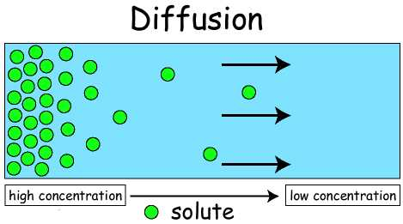
Remember Diffusion??
Movement of particles from high concentration to low.

Slide 3
osmosis
The diffusion of water
What is diffusion??? Hint: We just said it.

Slide 4
The Tonics
Isotonic---water flow is equal
Hypotonic---water flows into cell
Hypertonic---water flows out of cell.

Slide 5
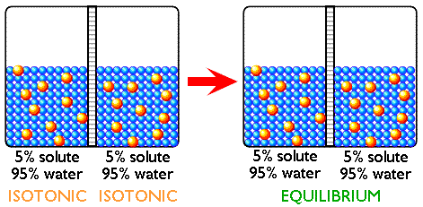
Isotonic solution
Concentrations of dissolved particles (solute) are the same both inside and outside the cell.

Slide 6
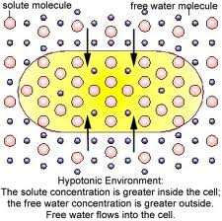
Hypotonic solution
Concentration of dissolved particles is lower outside the cell than inside.

Slide 7
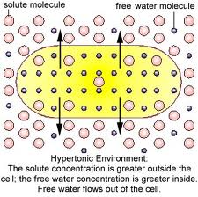
Hypertonic solution
Concentration of dissolved particles is higher outside the cell than inside

Slide 8
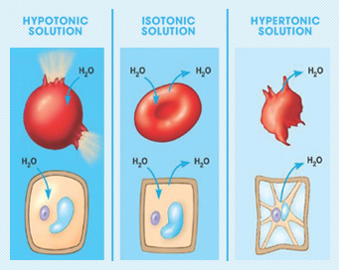
What happens to cells in these solutions?

Slide 9
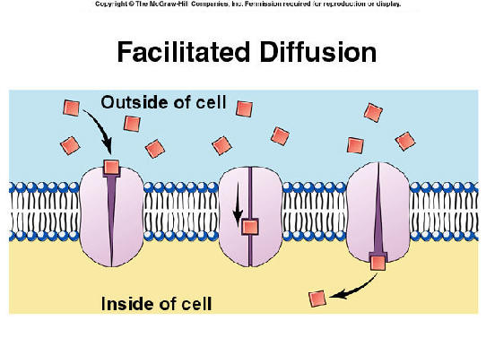
Facilitated diffusion
Particles that need to be moved are unable to do so on their own.
They rely on channel or transport proteins to carry them

Slide 10
Passive transport
Does not require energy to move substances across membranes
Substances move with a concentration gradient (high to low)
Examples – diffusion, osmosis, facilitated diffusion

Slide 11
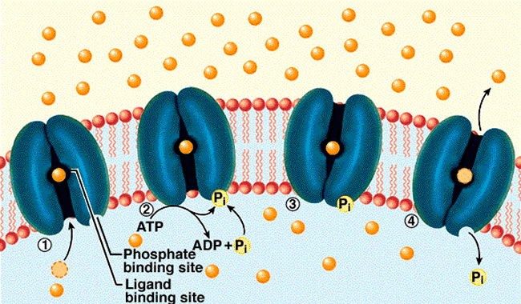
Active transport
Moves particles from an area of low concentration to an area of high concentration
Requires energy

Slide 12
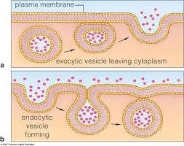
Transport of large particles
Endocytosis (stuff coming in...enter)
Exocytosis (stuff going out...exit)
Both processes require energy because they change the membrane of the cell

