Slide 1
Chapter 6.2
Water and Diffusion

Slide 2
Water’s Importance
Most life processes can occur only when molecules and ions are free to move and collide with one another, and that condition exists when they are dissolved in water
Water transports materials in organisms (blood, tree sap)
Water makes up 70- 95% of most organisms

Slide 3
Water is Polar
A Polar Molecule is a molecule with an unequal amount distribution of charge; that is, each molecule has a positive end and a negative end.
Since water is polar it can dissolve many ionic compounds like salt, and many other polar molecules, such as sugar.

Slide 4
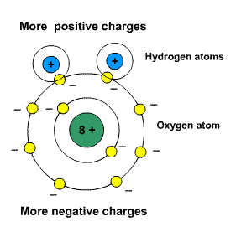

Slide 5
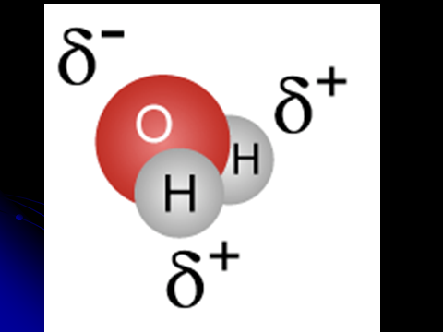
Polar Molecule

Slide 6
Hydrogen Bond
The attraction of positively charged hydrogen atoms in one water molecule with negatively charged oxygen atoms of another water molecule forms a hydrogen bond.
Hydrogen bond is very important to living organisms because it holds many biomolecules (like protein) together.

Slide 7
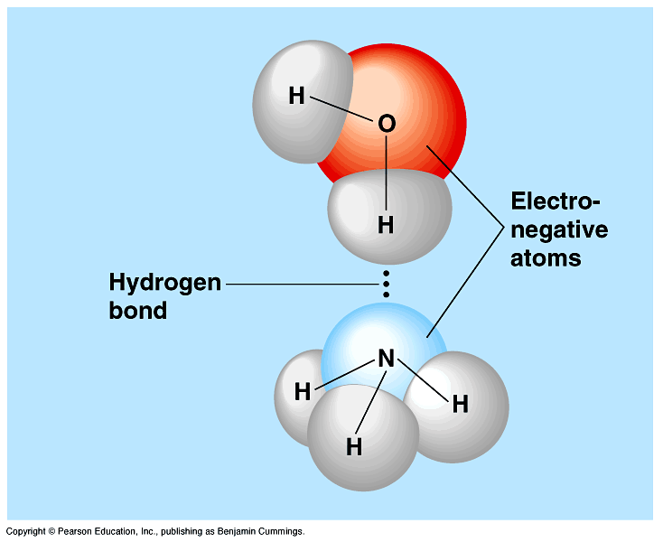

Slide 8
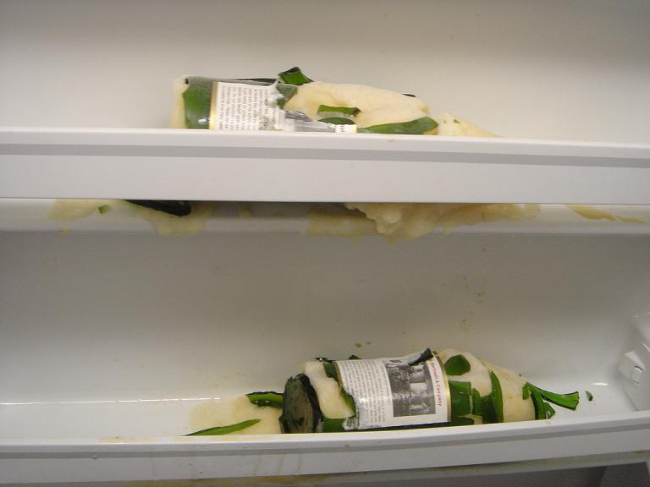
Freezing Water
Water expands when it freezes.
That’s why a glass cup shatters when it’s filled with water and put into a freezer.

Slide 9
Background info on Diffusion
All moving objects have energy of motion called kinetic energy.
A moving particle of matter will move in a straight line until it collides with another particle. Afterwards it, and the other particle, will rebound.
Particles are like tennis balls, they are constantly moving and colliding with each other.

Slide 10
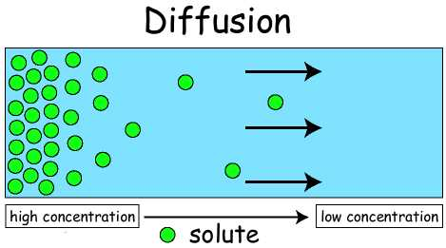

Slide 11
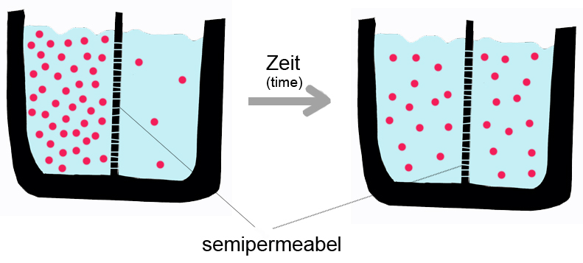
The net movement of particles from where there is a lot to where there is little….
Until equal amounts on both sides

Slide 13
The Process of Diffusion
Diffusion: The net movement or particles from an area of higher concentration to an area of lower concentration.
Diffusion is slow because it relies on the random motion of atoms and molecules.

Slide 14
Necessary to make sure nutrients and waste are delivered to the appropriate location in a cell
Three things affect the rate of diffusion:
Concentration
Temperature
Pressure

Slide 15
The Results of Diffusion
Molecules will continue to move randomly and collide with one another, but no further change in concentration will occur.
This is called Dynamic Equilibrium.

Slide 16
Diffusions in Living Systems
Diffusion in biological systems is also evident outside of the cell and can involve substance other than molecules in an aqueous environment.
Oxygen (a gas) diffuses in capillaries of the lungs because there is a greater concentration of oxygen in the air sacs of the lungs than in the capillaries.

Slide 17
Brownian Motion
In 1827,Scottish scientist Robert Brown was observing pollen grains that were floating in water. He noticed that the grains jerked around in the water.
That was a result of the random motion of atoms and molecules.

