Slide 1
Cell Division - Mitosis
Chapter 8.2….page 201

Slide 2
Cell Size
Large cells are inefficient
Wastes and nutrients cannot be moved quickly
DNA can only make so much protein

Slide 3
Solution?
Divide or die!
Small cells are able to perform life functions more easily than large cells.
Example?

Slide 4
The Cell Cycle
Sequence of growth and division of a cell
Consists of two parts:
Interphase
Mitosis

Slide 5
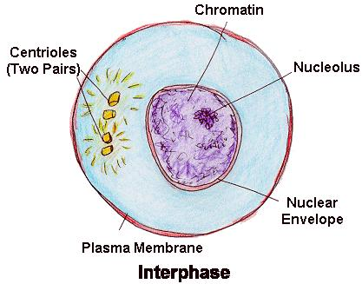
Interphase
Busiest and longest period of a cell cycle
G1- cell grows and proteins are made
S phase – cell copies chromosomes
G2 – organelles are made; cells parts for division are assembled

Slide 6
Mitosis
Series of phases involved in the division of a cell’s nucleus

Slide 7
Prophase
Longest phase of mitosis
Chromatin becomes visible chromosomes
Sister chromatids are held together by centromere
Nucleus and nucleolus disappear
Centrioles begin to move to opposite ends of cell
Spindles form from centrioles

Slide 8
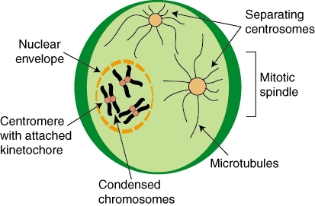
Prophase

Slide 9
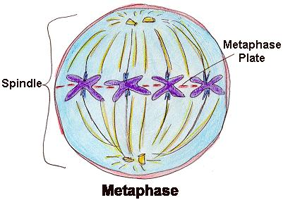
Metaphase
Shortest phase of mitosis
Centromere attaches to spindle fibers
Chromosomes line up at equator

Slide 10
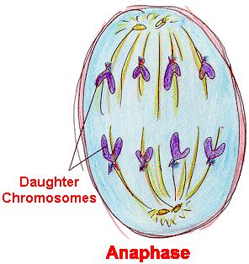
Anaphase
Centromeres split
Sister chromatids are pulled apart

Slide 11
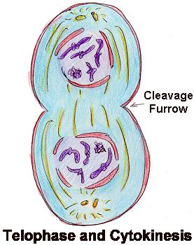
Telophase
Chromatids are at opposite ends
Chromosomes unwind and become chromatin
Spindles break apart
Nucleus and nucleolus reappear

Slide 12
Cytokinesis
Division of cytoplasm
Occurs toward end of telophase
Animal cell – cell membrane pinches in
Plant cell – cell plate is laid down between new nuclei

Slide 13
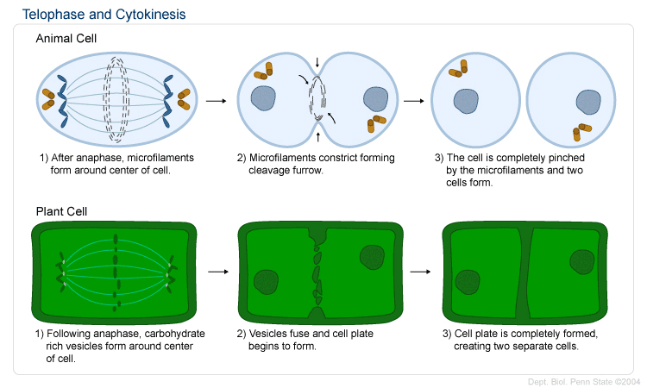
Telophase and Cytokinesis

Slide 14
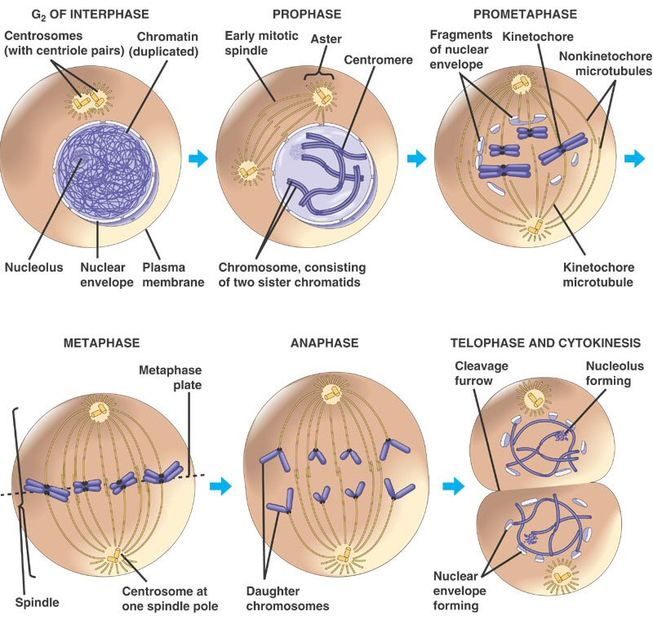

Slide 15
Results of Mitosis
Produces 2 genetically identical cells
Can be used by single-celled organisms to reproduce
In multi-celled organisms used for producing tissues → organs → organ systems

