Slide 1
Cell transport
Sections 6.2 & 8.1

Slide 2
diffusion
The net movement of particles from where there is a lot to where there is little
Happens because particles are always moving randomly

Slide 3
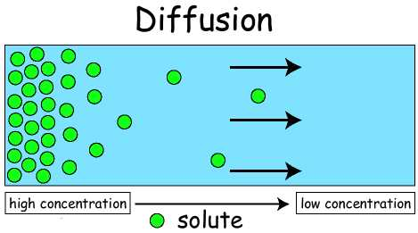

Slide 4
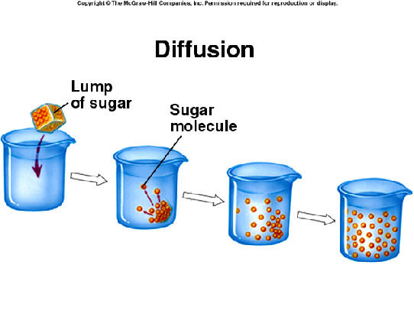

Slide 5
Necessary to make sure nutrients and waste are delivered to the appropriate location in a cell
Three things affect the rate of diffusion:
Concentration
Temperature
Pressure

Slide 6
water
Transports materials
Resists temperature change
Allows substances to be dissolved so they can interact

Slide 7
osmosis
The diffusion of water

Slide 8
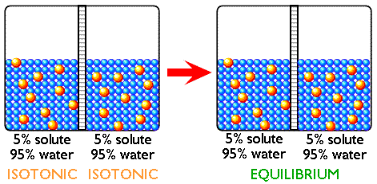
Isotonic solution
Concentrations of dissolved particles (solute) are the same both inside and outside the cell.

Slide 9
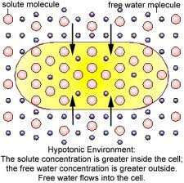
Hypotonic solution
Concentration of dissolved particles is lower outside the cell than inside.

Slide 10
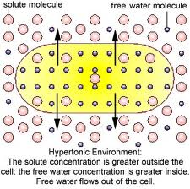
Hypertonic solution
Concentration of dissolved particles is higher outside the cell than inside

Slide 11
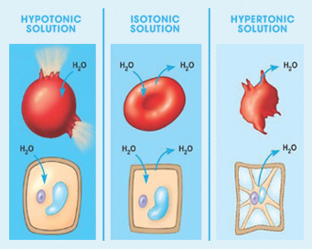
What happens to cells in these solutions?

Slide 12
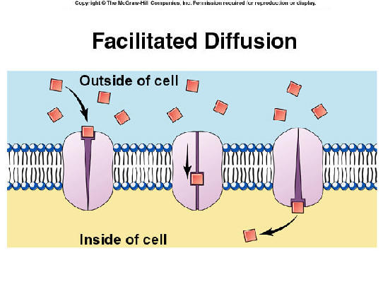
Facilitated diffusion
Particles that need to be moved are unable to do so on their own.
They rely on channel or transport proteins to carry them

Slide 13
Passive transport
Does not require energy to move substances across membranes
Substances move with a concentration gradient (high to low)
Examples – diffusion, osmosis, facilitated diffusion

Slide 14
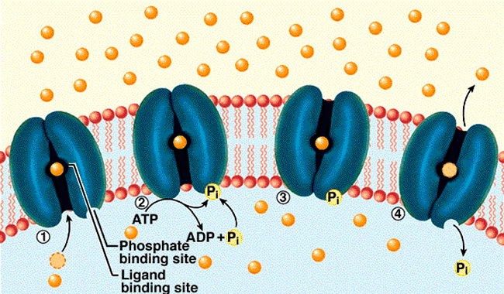
Active transport
Moves particles from an area of low concentration to an area of high concentration
Requires energy

Slide 15
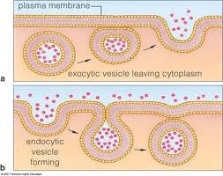
Transport of large particles
Endocytosis
Exocytosis
Both processes require energy because they change the membrane of the cell

